Slide 1
Classifying apps reviews
GABRIELIDIS Hugo

Slide 2
Motivation
Apps reviews are an useful for developers : Being sure you app is still appreciated by the users taking notice of the bugs they encounter and the features they want to see implement is important.
However for bigs apps there are too much reviews for human to analyze manually, and sometimes the review aren’t meaningful
-> It is important to implement algorithm that would categorize each reviews in one of the four category : Bugs, User Experience, Feature Request & Rating
So the four category can be send to a developers that can focus on them

Slide 3
Problem
Creating an Algorithm that would be able to categorize with a good accuracy apps reviews
I wanted to implement various algorithm and compare the results they got on classifying those apps review
I wanted to see which words would be considered as represent of each category by my classifier

Slide 4
Technique
The DataSet
Preprocessing the data
Binary classification with Keywords
Machine Learning Method
Knn
LinearSVC
MultinomialNB
DecisionTree
Neuronal Network
ANN
CNN
Bonus : Words that represent each category

Slide 5
I) DataSet
A DataSet that contains 3691 reviews each labeled under one of the four category. The repartition of the category was not uniform ( Rating was too much present) -> I took 600 of each category which makes 2400 label reviews
Other DataSets without label that could have been used.

Slide 6
II) Preprocessing the Data
Remove stops word
Lower case
Lemmatizer
TF-IDF Vectorizer ( remove all words that doesn’t appear more than 3 times & take into account bigram and trigram)

Slide 7
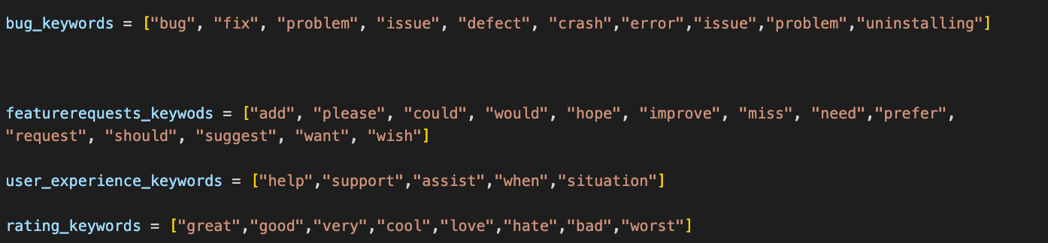
I) Binary classification with Keywords
Keywords methods :
Accuracy : 0.23

Slide 8
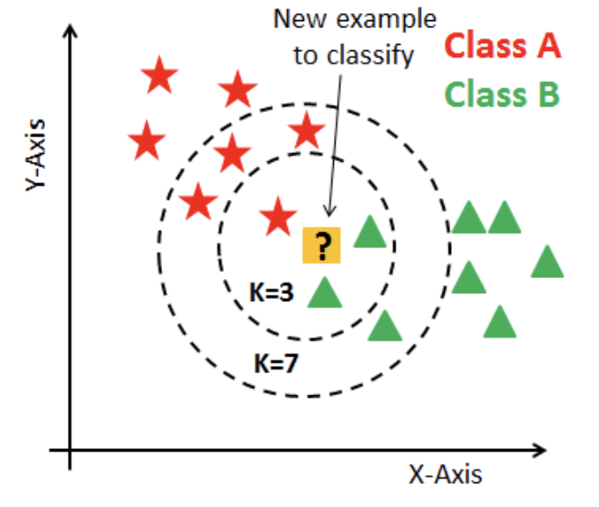
II) Machine Learning Method
a ) KNN (K-Nearest Neighbors)
In our dataset cases using a loop we find that the best
k is k = 12

Slide 9
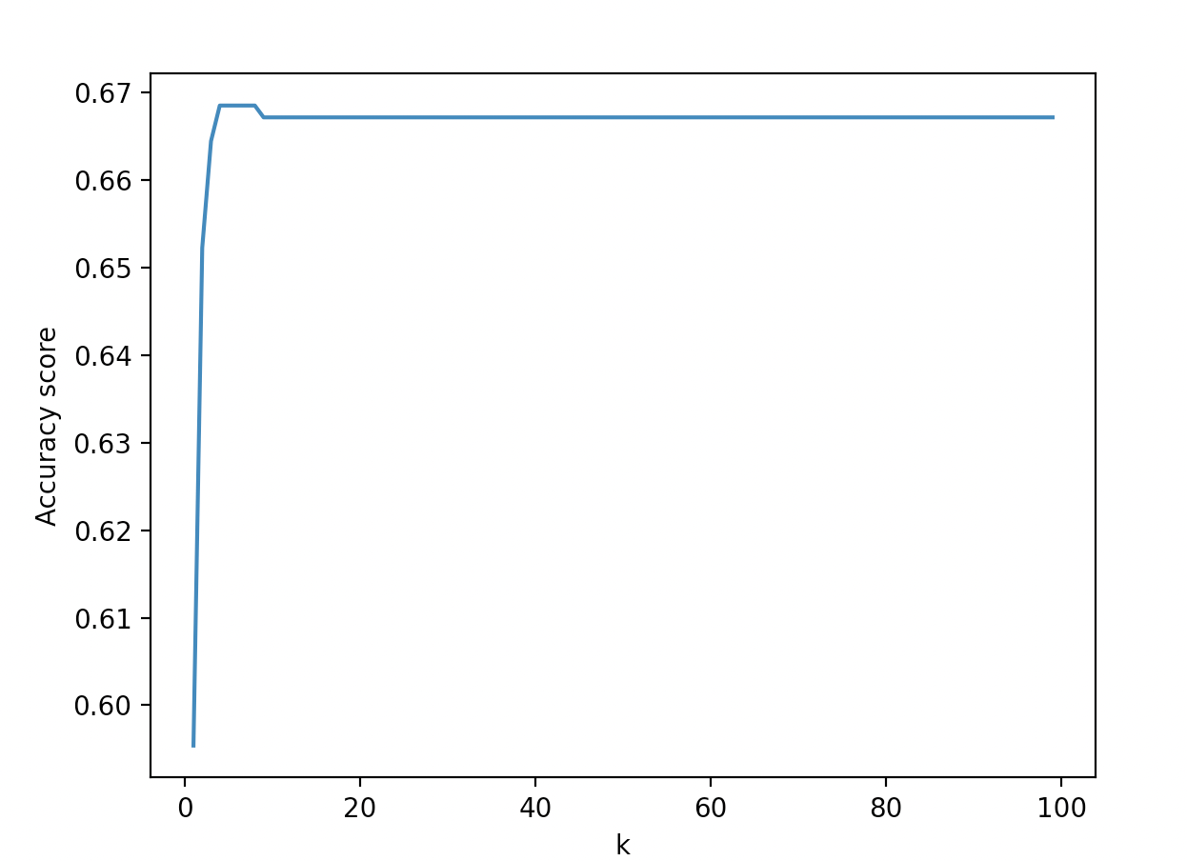
II) Machine Learning Method
a ) KNN (K-Nearest Neighbors)

Slide 10
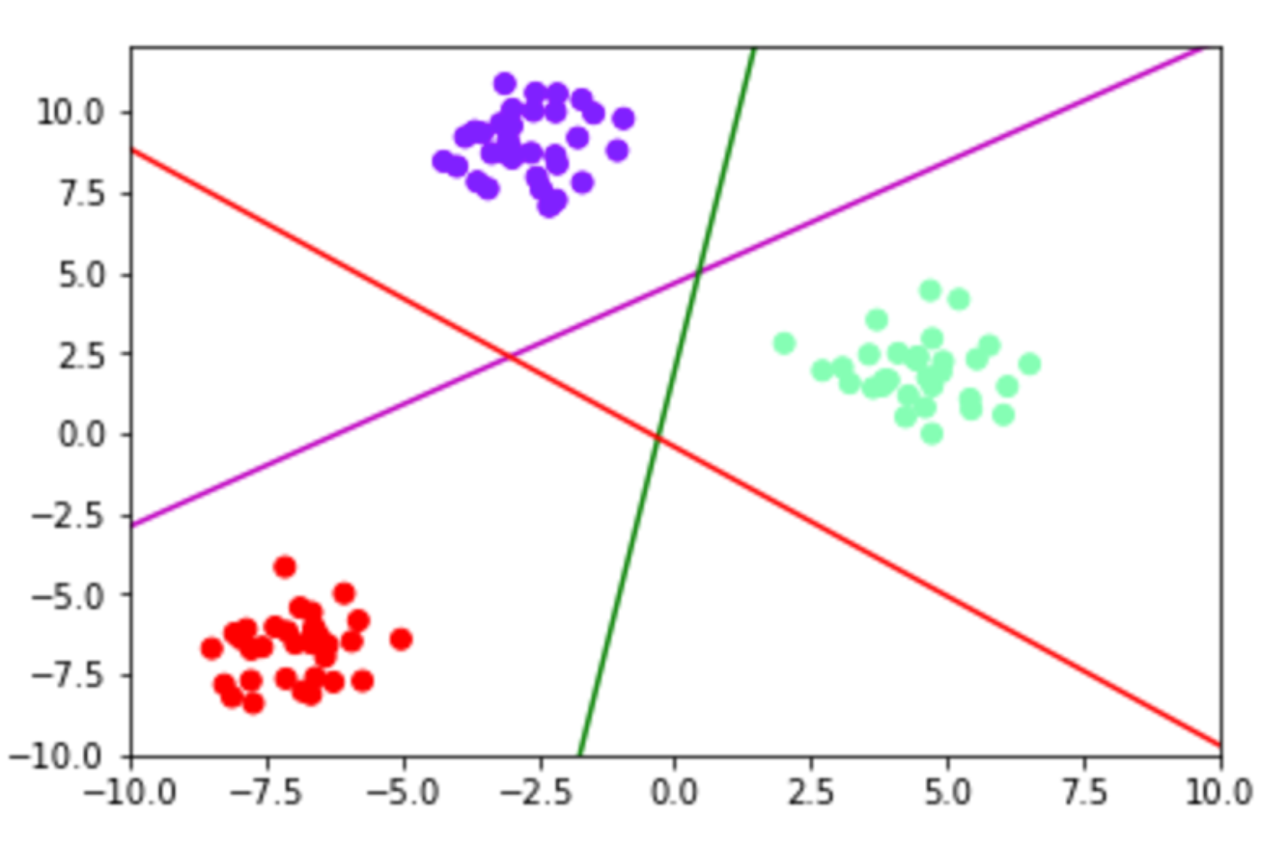
II) Machine Learning Method
B) LinearSVC

Slide 11
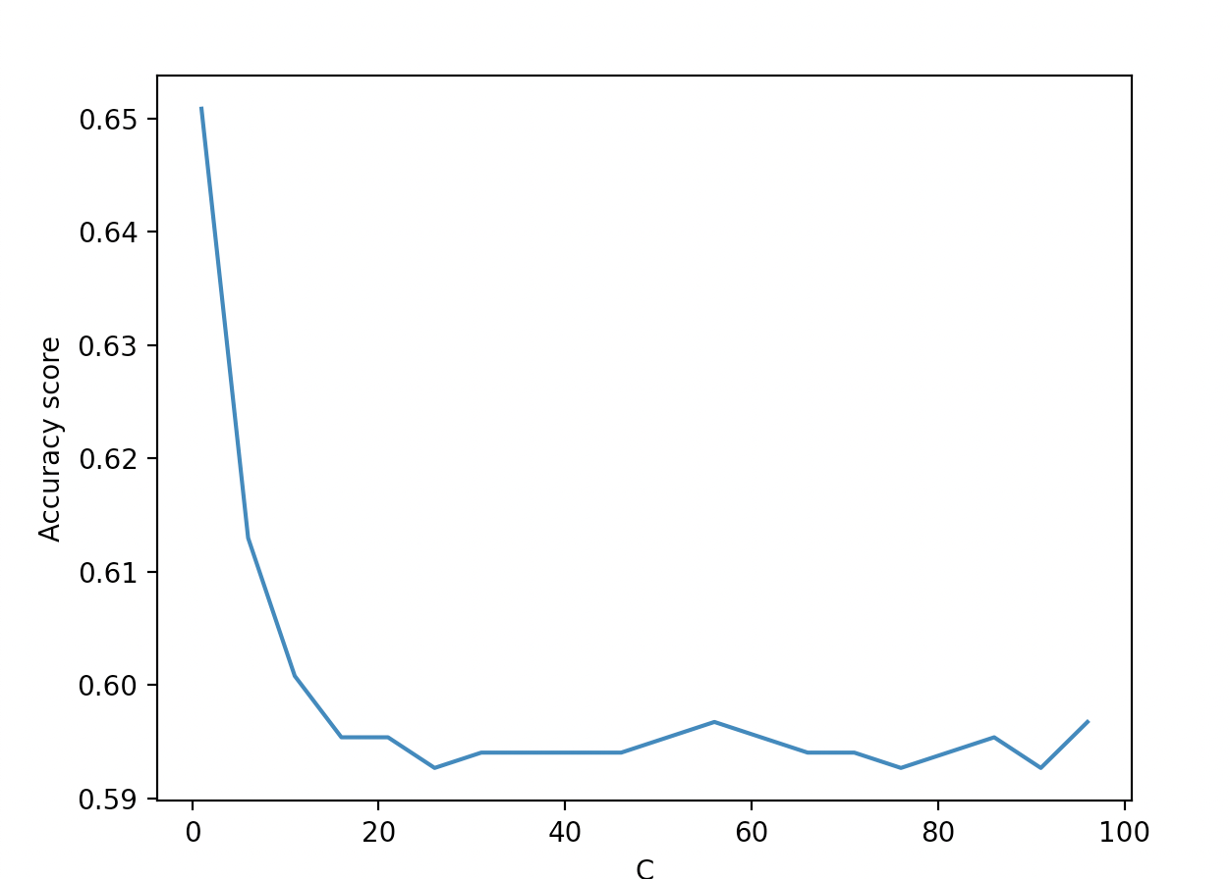
II) Machine Learning Method
B) LinearSVC

Slide 12
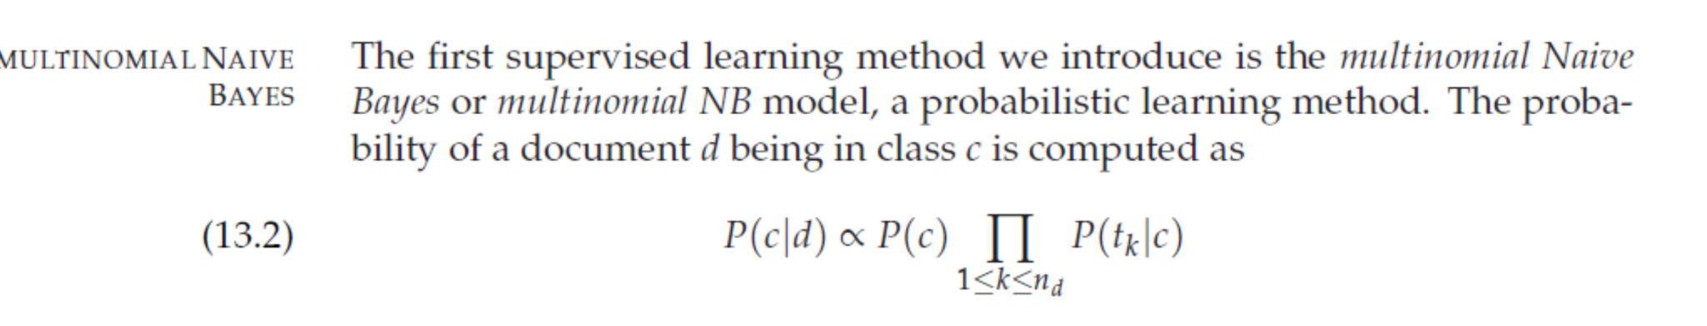
II) Machine Learning Method
C) MultinomialNB
P(tk|c) = Interpret as a measure of how much evidence tk contributes that c is the correct class
P(c) = Prior Probability a document occuring in class c

Slide 13
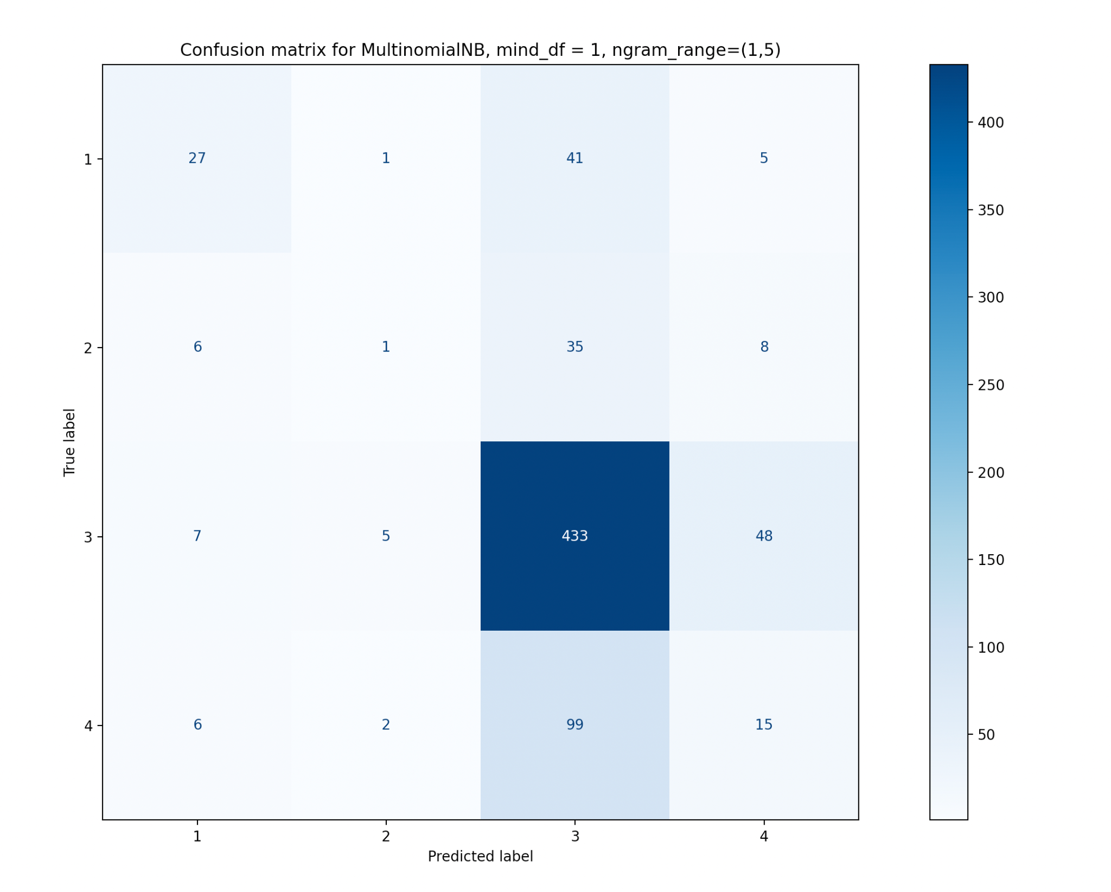
II) Machine Learning Method
C) MultinomialNB
On average we find an accuracy of 0.65
Confusion matrix :

Slide 14
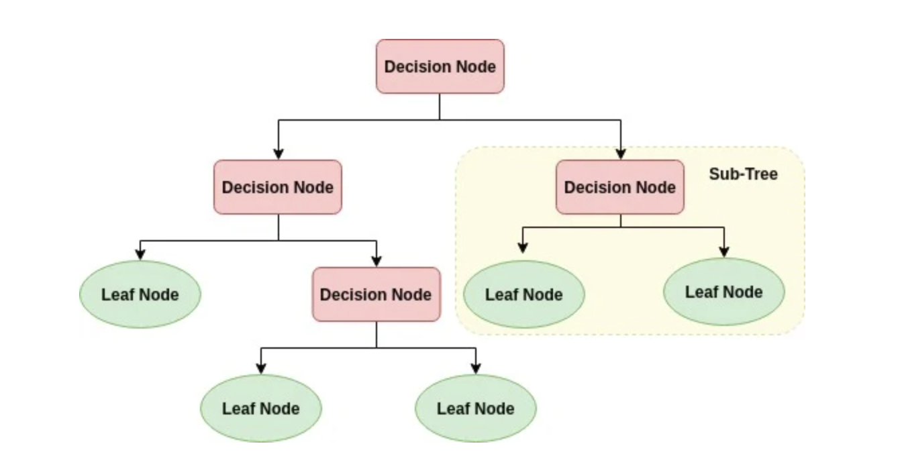
II) Machine Learning Method
D) DecisionTree

Slide 15
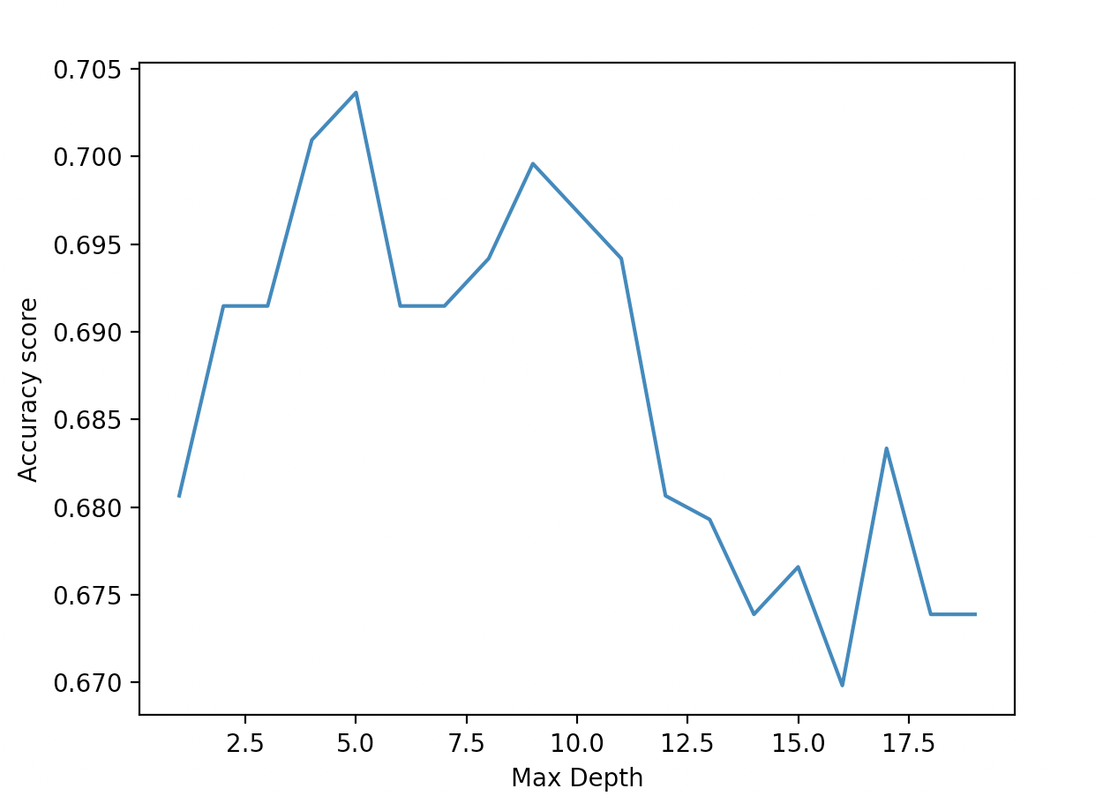
II) Machine Learning Method
D) DecisionTree

Slide 16
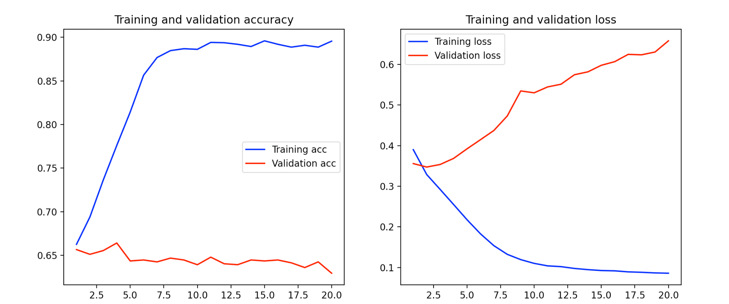
III) Neuronal Network
Embedding + One hidden layer of 10 neurons
-> Overfitting

Slide 17
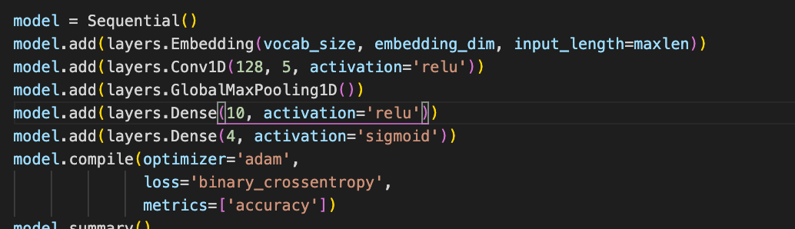
III) Neuronal Network
B) CNN

Slide 18
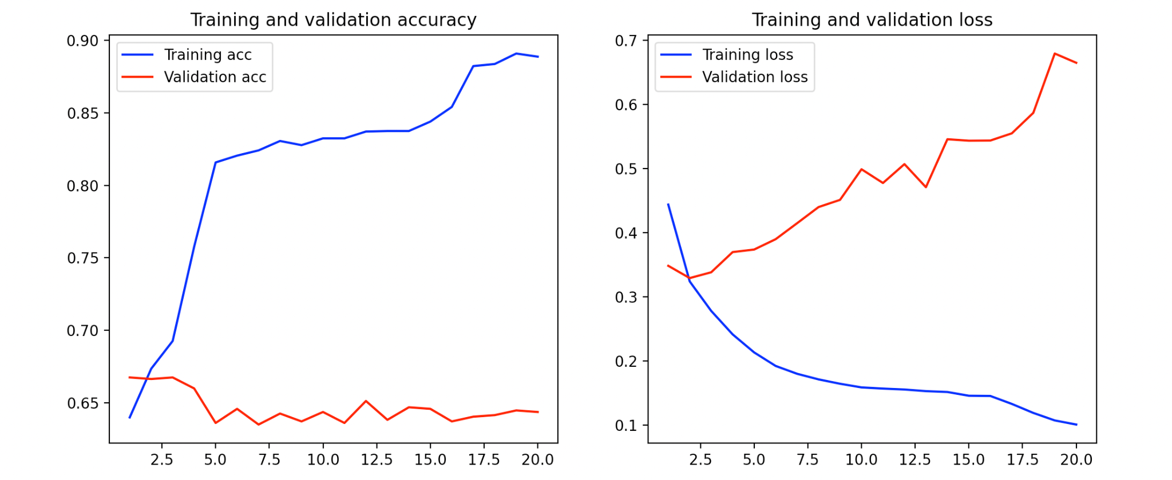
III) Neuronal Network

Slide 19
Evaluation
For the ML model we take the parameters that gave the best value same for number of epoch
 | Binary Classifier | KNN | LinearSVC | MultinomialNB | Decision Tree | ANN | CNN
Average accuracy over 10 test | 0.23 | 0.66 | 0.665 | 0.65 | 0.7 | 0.67 | 0.69

Slide 20
Comparaison with other paper
On the Automatic Classification of App Reviews :
Per category : Bugs : 0.71 Feature: 0.76 UserExperience 0.69 Rating : 0.8
-> Overall Accuracy of 0.74
What Would Users Change in My App? ( Not exactly the same )
-> Accuracy of 0.74

Slide 21
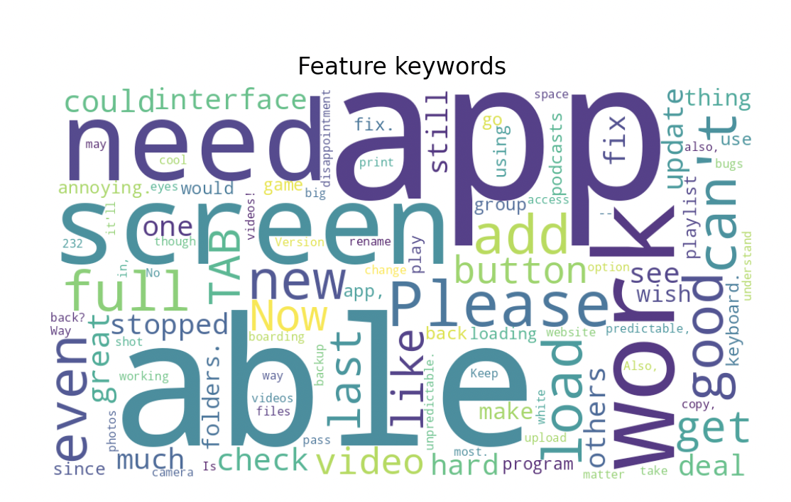
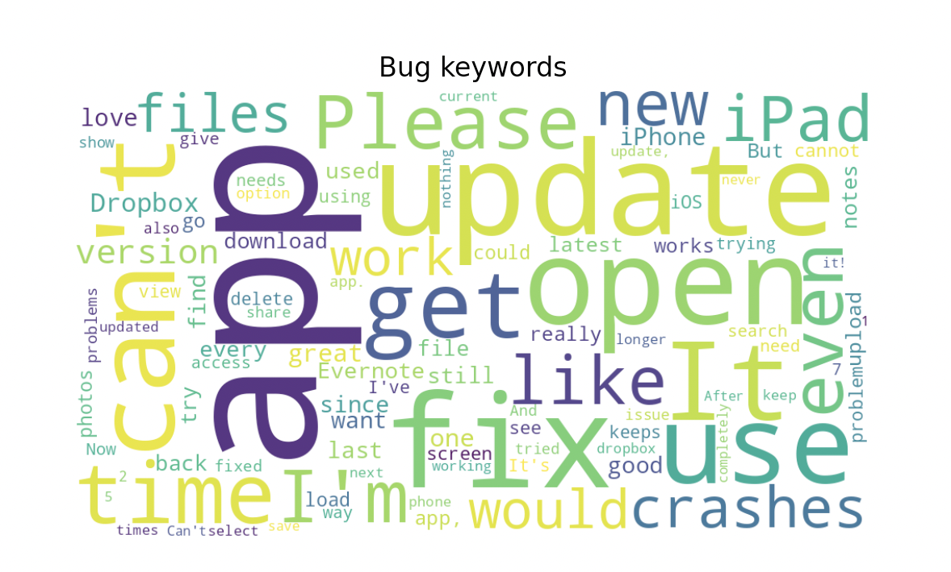
Bonus : Words that represent each category

Slide 22
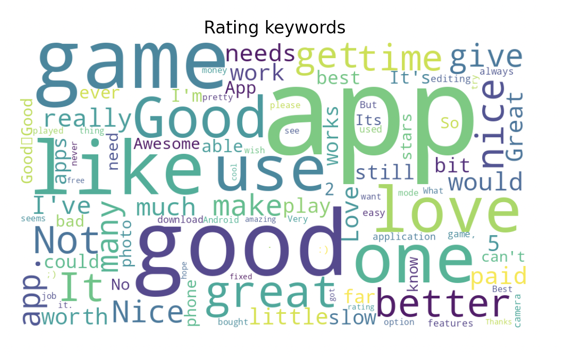
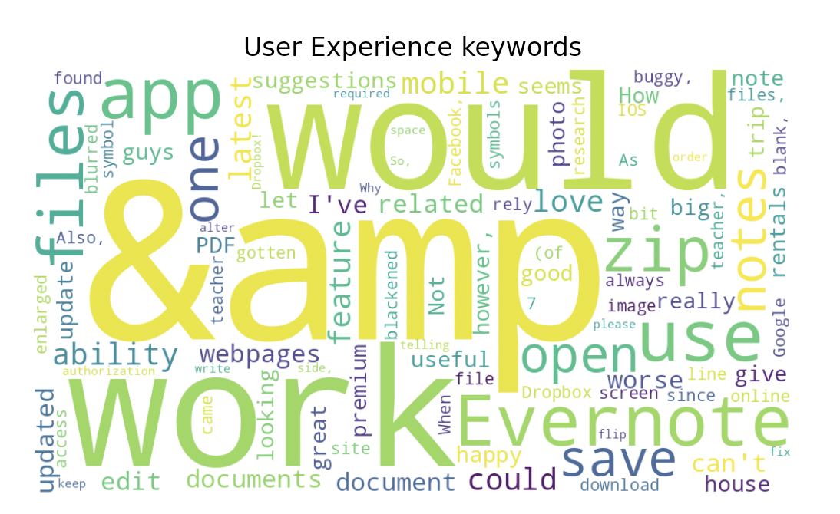
Bonus : Words that represent each category

Slide 23
Possible Improvement
Testing different type of datapreprocessing ( embedding methods) : Words2Vec, BERT…
Analysis of feature selection then visualisation of the data
Figuring for each ML model which parameters gives the best model
Other DeepLearning Model that are better for NLP classification : RNN, LSTM Transformer…
Use other evaluation Metrics : Precision, Recall, F1-score...

